Slide 1

jQuery, Ajax, HTML 5
Date : Nov 14, 2016
Rajesh K – Crew Pay

Slide 2

Agenda
jQuery, Ajax, HTML 5
Introduction
Uses
Features
jQuery library
Code demo

Slide 3


Slide 4
What is jQuery?
jQuery is a JavaScript Library.
jQuery greatly simplifies JavaScript programming.
jQuery is easy to learn.
Who developed jQuery?
jQuery was originally released in August 2006 at BarCamp NYC by John Resig and was influenced by Dean Edwards' earlier cssQuery library.
Current version is 3.1 and released on July 7, 2016

Slide 5
How to import JQUERY Library in HTML file
<script src="jquery-3.1.1.js"></script>
(OR)
<script src="jquery-3.1.1.min.js "></script>
(OR)
It is also possible to include jQuery directly from a CDN:
<script src="https://code.jquery.com/jquery-3.1.0.min.js"></script>

Slide 6
USES OF JQUERY
jQuery simplifies HTML document traversing, event handling, animating, and
Ajax interactions for rapid web development.
DOM manipulation − The jQuery made it easy to select DOM elements, traverse them and
modifying their content by using cross-browser
jQuery pages load faster
jQuery easily integrates with the Visual Studio IDE

Slide 7
Features:
1. HTML/DOM manipulation
JQuery provides methods to manipulate DOM in efficient way. You do not need to write big code to modify the value of any element's attribute or to extract HTML code from a paragraph or division.
JQuery provides methods such as .attr(), .html(), and .val() which act as getters, retrieving information from DOM elements for later use.

Slide 8
2. CSS manipulation
The .css() method sets or returns one or more style properties for the selected elements.
To return the value of a specified CSS property, use the following syntax:
css("propertyname");

Slide 9
3. HTML event methods
Event methods trigger or attach a function to an event handler for the selected elements
Example:
mouseenter() : Triggers mouse entered
mouseleave() : Triggers mouse left from the attribute
blur() : Attaches/Triggers the blur event
click() : Attaches/Triggers the click event
………..

Slide 10
4. Effects and animations
The jQuery animate() method lets you create custom animations
Syntax:
$(selector).animate({params},speed,callback);
The required params parameter defines the CSS properties to be animated.
The optional speed parameter specifies the duration of the effect. It can take the following values: "slow", "fast", or milliseconds.
The optional callback parameter is a function to be executed after the animation completes.
The following example demonstrates a simple use of the animate() method; it moves a <div> element to the right, until it has reached a left property of 250px:
Example
$("button").click(function(){ $("div").animate({left: '250px'}); });

Slide 11
What is DOM?
The Document Object Model (DOM) is a cross-platform and language-independent
convention for representing and interacting with objects in HTML, XHTML, and XML
documents. The nodes of every document are organized in a tree structure, called the DOM tree.

Slide 12
JQUERY REFERENCE LINK :
https://jquery.com/
https://jqueryui.com/
http://www.w3schools.com/jquery/

Slide 13


Slide 14
What is AJAX?
Ajax is a client-side script that communicates to and from a server/database without page refresh.
In other words Ajax is “the method of exchanging data with a server, and updating parts of a web page – without reloading the entire page
AJAX stands for Asynchronous JavaScript and XML.

Slide 15
Uses:
Callbacks:
Ajax is used to perform a callback, making a quick round trip to and from the server to retrieve and/or save data without posting the entire page back to the server. By not performing a full postback and sending all form data to the server, network utilization is minimized and quicker operations occur. In sites and locations with restricted bandwidth, this can greatly improve network performance. Most of the time, the data being sent to and from the server is minimal. By using callbacks, the server is not required to process all form elements. By sending only the necessary data, there is limited processing on the server. There is no need to process all form elements, process the ViewState, send images back to the client, or send a full page back to the client.

Slide 16
2. Making Asynchronous Calls:
Ajax allows you to make asynchronous calls to a web server. This allows the client browser to avoid waiting for all data to arrive before allowing the user to act once more.

Slide 17
3. User-Friendly:
Because a page postback is being eliminated, Ajax enabled applications will always be more responsive, faster and more user-friendly.

Slide 18
4. Increased Speed:
The main purpose of Ajax is to improve the speed, performance and usability of a web application. A great example of Ajax is the movie rating feature on Netflix. The user rates a movie and their personal rating for that movie will be saved to their database without waiting for the page to refresh or reload. These movie ratings are being saved to their database without posting the entire page back to the server.

Slide 19
AJAX request call:
$.ajax({
type: "POST",
url: 'test.php',
data: {"data":"check"},
datatype: ‘json’,
async:false
success: function(data){
alert(data);//This will alert Success which is sent as the response to the ajax from the server
}
});

Slide 20
AJAX REFERENCE LINK :
https://learn.jquery.com/ajax/
http://www.w3schools.com/xml/ajax_intro.asp
http://www.tutorialspoint.com/ajax/

Slide 21


Slide 22
What is HTML 5? HTML5 is a markup language used for structuring and presenting content on the World Wide Web. It is the fifth and current version of the HTMLstandard.

Slide 23
Uses: Better Interactions Smarter Storage Cleaner Code Doctype Accessibility

Slide 24
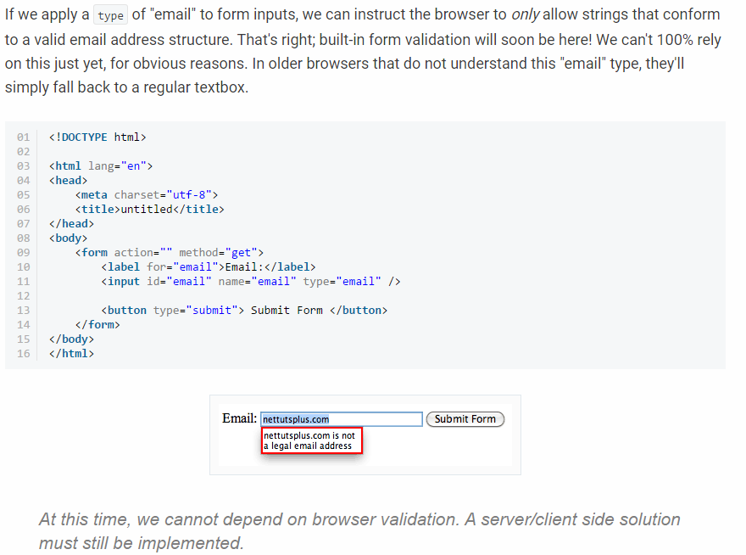
1. Email Inputs

Slide 25
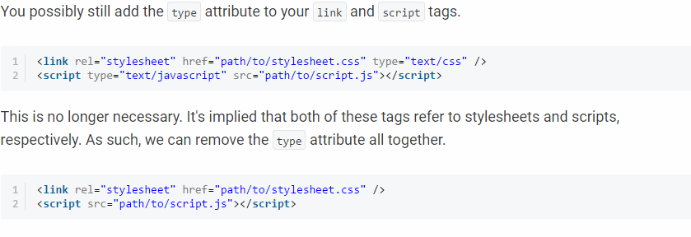
2. No more Types for Scripts and Links

Slide 26
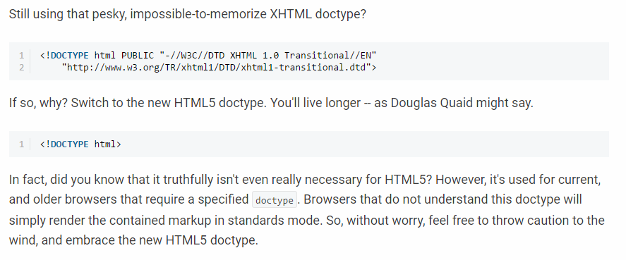
3. New Doctype and lot more features

Slide 27
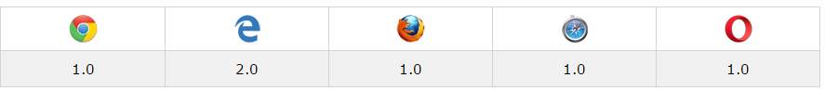
Browser support

Slide 28
HTML5 REFERENCE LINK :
https://code.tutsplus.com/tutorials/28-html5-features-tips-and-techniques-you-must-know--net-13520
http://www.w3schools.com/tags/default.asp
https://webdesignerhut.com/top-15-features-of-html5-that-every-developer-must-know/

Slide 29

Questions?

Slide 30
Thank you

